Slide 1
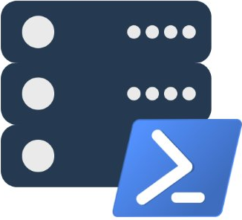
Modern Database Administration with PowerShell and dbatools
Presented by @cl and @mobileck
dbatools.io | dbatools.io/slack | dbatools.io/youtube | sqlps.io

Slide 2
About
Chrissy LeMaire - @cl
SQL Server DBA with General Dynamics IT at NATO Spec Ops HQ
PowerShell MVP
Creator of dbatools.io
Constantine Kokkinos - @mobileck
SQL Server DBA at Avionte Software
Apple Certified Trainer
dbatools Major Contributor & git merger extraordinaire
dbatools.io | dbatools.io/slack | dbatools.io/youtube | sqlps.io

Slide 3
OHH! We’re doing a Summit pre-con!
October 31, Seattle WA
Around 8 hours of awesome!
Lab included
sqlps.io/precon
dbatools.io | dbatools.io/slack | dbatools.io/youtube | sqlps.io

Slide 4

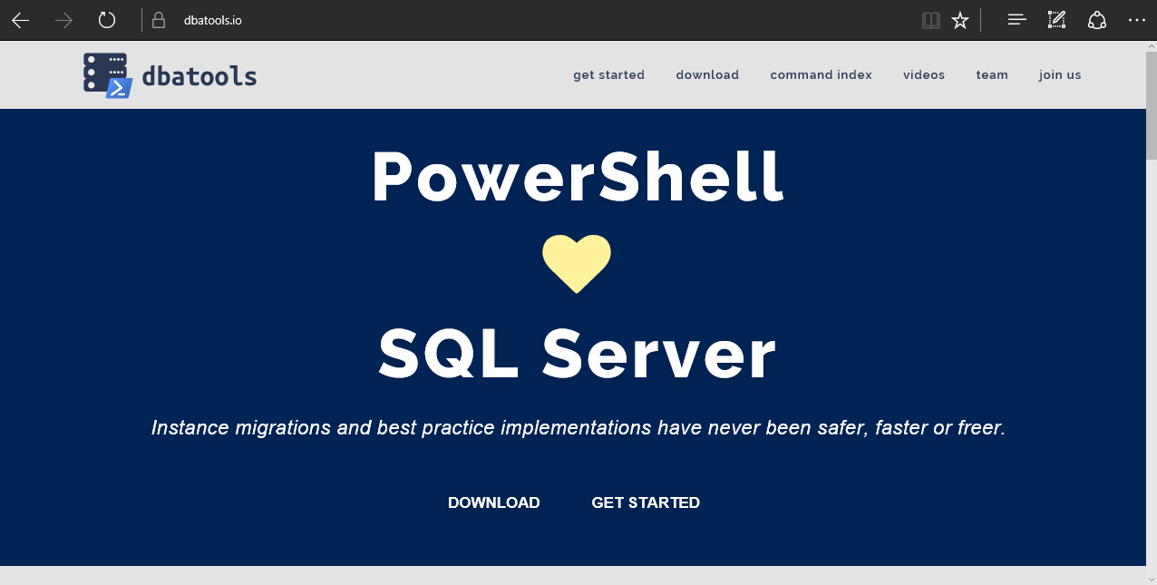
dbatools
dbatools.io | dbatools.io/slack | dbatools.io/youtube | sqlps.io
Notes:
Community project, initially started out as Start-SqlMigration but has grown into a DBA’s best friend. dbatools currently sports 100 commands.
How many of you have heard of dbatools? How many of you have used it?

Slide 5
System Requirements
Minimum
Client
PowerShell v3
SQL Server Management Studio / SMO 2008 R2
Server
SQL Server 2000
No PowerShell for pure SQL commands
PowerShell v2 for Windows commands
Remote PowerShell enabled for Windows commands
Recommended
Client
PowerShell v5.1
SQL Server Management Studio / SMO 2008 R2
Server
SQL Server 2008R2+
dbatools.io | dbatools.io/slack | dbatools.io/youtube | sqlps.io
Notes:
Started as a migration tool, so I strived to support older environments
No reliance on SQLPS, because we’ve got a history ;)

Slide 6
Install is easy
PowerShell Gallery
Install-Module dbatools
Install-Module dbatools –Scope CurrentUser
GitHub – dbatools.io/git
Invoke-Expression (Invoke-WebRequest dbatools.io/in)
dbatools.io | dbatools.io/slack | dbatools.io/youtube | sqlps.io
Notes:
Gallery requires admin access and is built into PowerShell v5. Other versions also support it with a bit of configuration.
Download
Unzip
Import-Module

Slide 7
Visit the website
dbatools.io | dbatools.io/slack | dbatools.io/youtube | sqlps.io
Notes:
Community project, initially started out as Start-SqlMigration but has grown into a DBA’s best friend. dbatools currently sports 100 commands.
How many of you have heard of dbatools? How many of you have used it?

Slide 8
demo
dbatools.io | dbatools.io/slack | dbatools.io/youtube | sqlps.io

Slide 9

Community got us feelin’ like
dbatools.io | dbatools.io/slack | dbatools.io/youtube | sqlps.io
Notes:
Cut it out.

Slide 10
Review
PowerShell is a data pro’s best friend Migrations Best Practices Reporting
Join us! dbatools.io/slack #dbatools
dbatools.io/youtube
dbatools.io | dbatools.io/slack | dbatools.io/youtube | sqlps.io

Slide 11
How to Get-Help
Extensive documentation within each command Get-Help Start-DbaMigration –Detailed
Extensive documentation on dbatools.io
dbatools.io/Start-DbaMigration
dbatools.io/Repair-DbaOrphanUser
Some commands have videos
dbatools.io/youtube
dbatools.io | dbatools.io/slack | dbatools.io/youtube | sqlps.io

